Slide 1






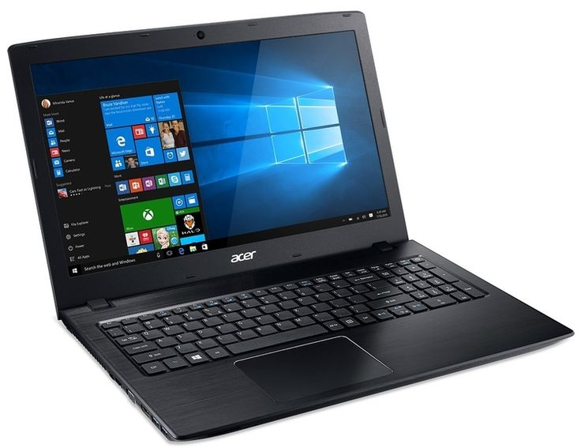
Information and Communication Technologies
Disadvantages
History
Characterizations
Application domains
Thank you
Definition
Conclusion
Types of ICT
Means used

Slide 2
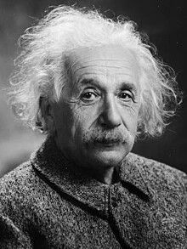
“Our technology has exceeded our humanity”.
Albert Einstein

Slide 3
Definition

Slide 4
Definition:
Information and Communication Technologies (ICT):
ICT refers to a set of interconnected technologies like computers, networks, and the internet that enable electronic creation, storage, processing, and access to information. It plays a central role in transforming data into meaningful information, empowering individuals and organizations to make informed decisions in the digital era.

Slide 5
History

Slide 6
History of ICT
The evolution of Information and Communication Technologies (ICT) is a fascinating story that spans several decades. Here is an overview of the history of ICT, from its beginnings to the present day:

Slide 7
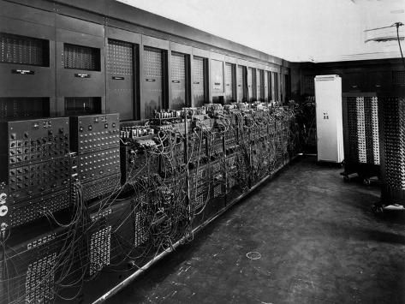
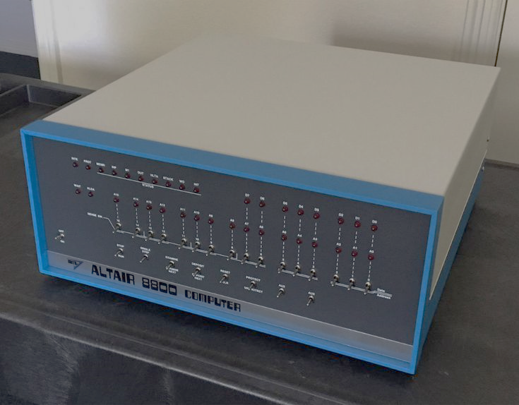
Early ICT development (1940s-1970s):
The evolution of electronic computing began in the 1940s with the development of the first computers like ENIAC during World War II.
Subsequently, the 1960s marked the emergence of mini-computers. In the 1970s, personal computing took a significant step forward with the creation of the first personal computers, exemplified by the Altair 8800.
ENIAC
Altair 8800

Slide 8
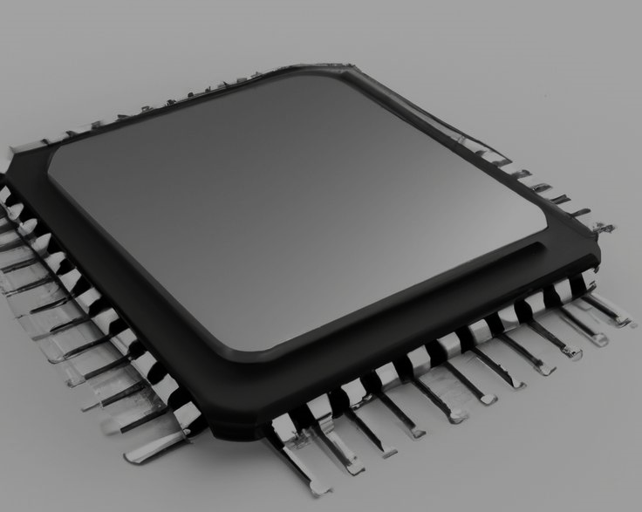

Microcomputing and digital transition (1980s-1990s):
The 1980s introduced microprocessors, resulting in computer miniaturization.
microprocessor
The following decade, the 1990s, witnessed the widespread popularity of the Internet, fundamentally transforming global communication, and giving rise to the World Wide Web (WWW).
Internet explorer logo

Slide 9
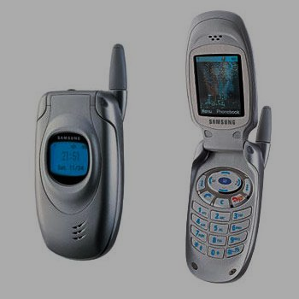
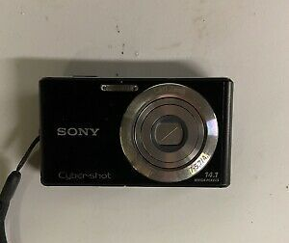


The 2000s marked the ascendancy of digital technologies, characterized by the widespread adoption of mobile devices, digital cameras.
Flip phone
Degital revolution (2000s-2010s):
Digital camera
In the following decade, the 2010s ushered in the era of social media, fundamentally reshaping personal and professional communication, accompanied by the proliferation of cloud computing.
Famous social medias

Slide 10
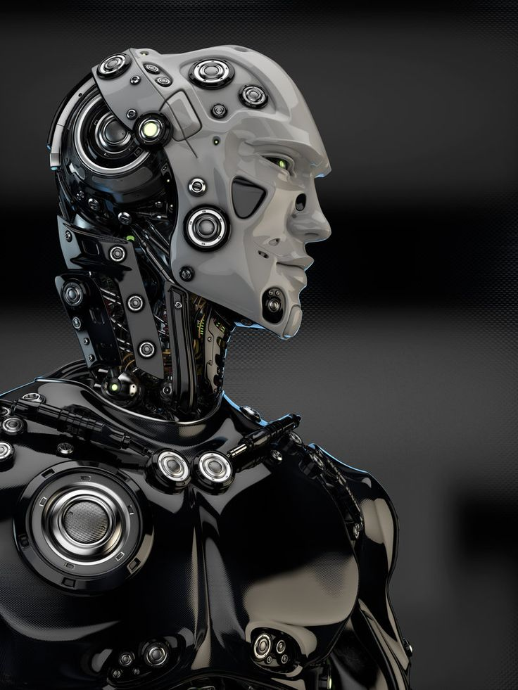
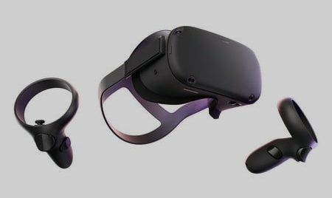
AI and IoT integration (2020s and beyond):
In the 2020s, Artificial Intelligence (AI) rose to prominence, influencing applications such as voice recognition, automatic translation, and chatbots. Simultaneously, the Internet of Things (IoT) gained traction, connecting physical devices to the Internet and fostering heightened automation and interconnectivity.
Virtual reality set
AI generated robot

Slide 11
Types of ICT

Slide 12
.
Types of ICT
ICT (Information and Communication Technologies):
ICT involves various technologies for managing information, spanning traditional methods and broadcasting alongside modern computing technologies.
NTIC (New Information and Communication Technologies):
NTIC encompasses cutting-edge technologies like AI, VR, blockchain, big data, and cloud computing, providing innovative solutions to modern challenges.
ICTE (Information and Communication Technologies in Education):
ICTE maximizes learning using ICT tools like computers and software, promoting collaboration and interactive teaching methods in education.
.

Slide 13
Characterizations of ICT

Slide 14
Characterizations of ICT
Advancement
Speed
Miniturization
Affordability
Power and Capabilities
Multichannel

Slide 15
Means used for ICT

Slide 16
Means used for ICT
Computers
Phones
Tablets
Televisions
Radio
Remote information exchange
Electronic chips

Slide 17
Application domains and ICT’s impact on them

Slide 18



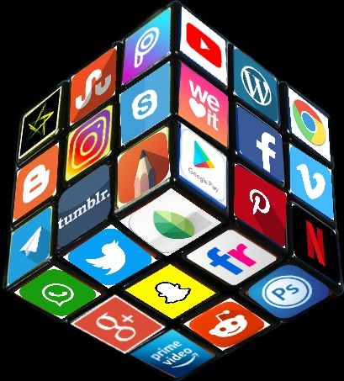

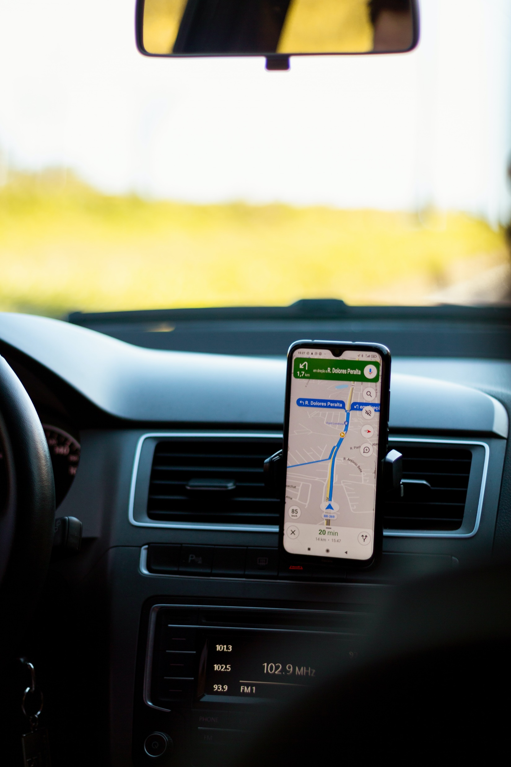
Application domains and ICT’s impact on them

Slide 19

Information Access

Slide 20
Information Access
ICT has transformed how we access information. The Internet provides rapid access to an immense amount of data, revolutionizing research, education, and knowledge sharing.

Slide 21

Connectivity and Communication

Slide 22
ICT has significantly enhanced global connectivity by facilitating instant communication on an international scale. Social networks, emails, video calls, and other platforms have brought individuals and cultures closer, fostering the exchange of ideas and information.
Connectivity and Communication

Slide 23
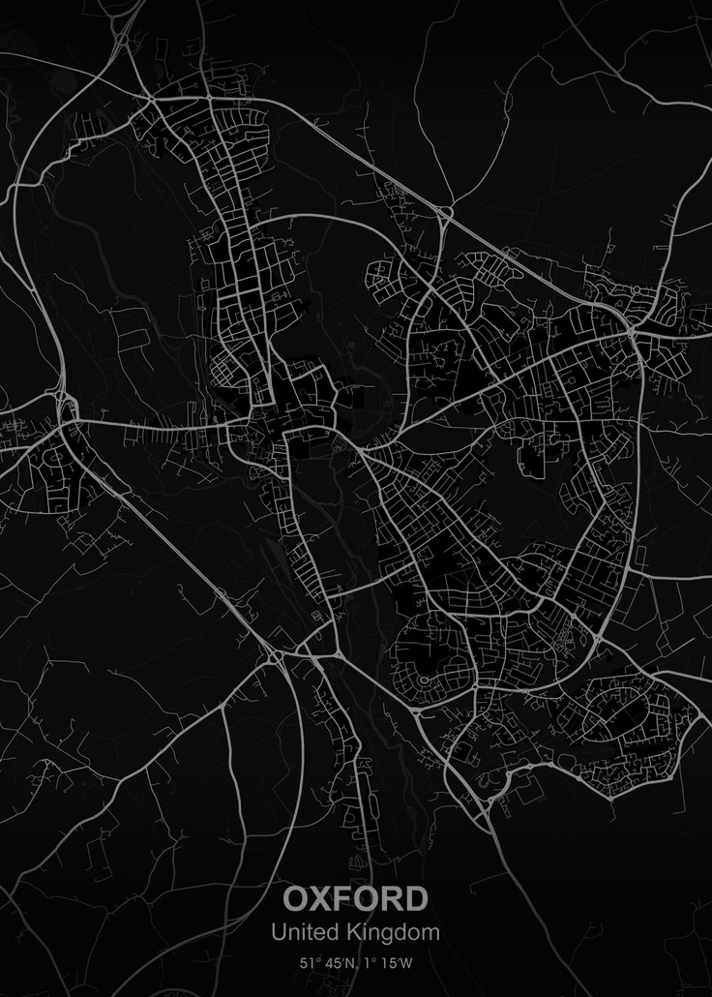
Geolocation

Slide 24

ICT allows for the tracking of people, objects, places, or events on a map, route calculation, retrieval of geographical information, sharing of location, and provision of personalized services based on location
Geolocation

Slide 25

Commerce

Slide 26
ICT fosters the development of e-commerce, allowing for online buying and selling, price comparison, consumer reviews, secure payments, home delivery, and online advertising. This has led to changes in traditional business models and the creation of new business opportunities.
Commerce

Slide 27

Work Transfromation

Slide 28
Work Transfromation
ICT has altered the nature of work with the emergence of remote work, online collaboration tools, and the automation of certain tasks. This has implications for work flexibility and the need to develop new skills.

Slide 29

Education

Slide 30
ICT facilitates learning, teaching, training, research, and remote collaboration. It provides diverse educational resources, interactive tools, exchange platforms, and assessment devices. This has expanded access to education globally.
Education

Slide 31

Health

Slide 32
ICT has revolutionized the healthcare sector by remoting healthcare services, management of medical records, telemedicine, patient monitoring, disease diagnosis, prevention of health risks, and promotion of health, health tracking apps
Health

Slide 33
ICT has applications in other areas such as agriculture, industry, energy, culture, entertainment, etc. Therefore, ICT serves as tools that can have both positive and negative impacts on society, the economy, the environment, and development.

Slide 34
The disadvantages of ICT

Slide 35
The disadvantages of ICT
Technological Dependence: Society is becoming increasingly dependent on technology.
Security and Confidentiality: Security and privacy concerns are significant, especially concerning the storage and transmission of sensitive data.
Impact on Employment: Automation and artificial intelligence may lead to the elimination of certain traditional jobs and require specialized skills.
Information Overload: The massive amount of available information can result in information overload.
Health Issues: Intensive use of electronic devices can lead to health problems, such as eye disorders, sleep disturbances.
Cybercrime: The increased use of the Internet has also led to a rise in online criminal activities.
Rapid Obsolescence: Rapid technological advancements can quickly render equipment and software obsolete, requiring frequent updates.

Slide 36
Conclusion

Slide 37
Conclusion
Information and Communication Technologies (ICT) have profoundly impacted society by changing how we communicate, learn, work, and interact. They have introduced new opportunities and facilitated global connectivity.
However, the widespread use of ICT poses challenges in terms of security, privacy, ethics, and equitable access. Managing these challenges is crucial for responsible use.
In conclusion, ICT has already brought significant changes and promises exciting future developments that will influence our way of life, work, and interaction.

Slide 38
Thank you.
Made by:
Lounici Amel –Section C/ Groupe3-

